Slide 1
Introduction:
Quantum Computing and Machine Learning
By Prof. Abhishek Dixit
Dept. of Electrical Engineering
IIT Delhi

Slide 2
Outline of the lecture
Brief bio
Why quantum computing and machine learning?
Course coverage
What will we offer?
Skillsets tradeoffs
Other learning sources
Course evaluation

Slide 3
Outline of the lecture
Brief bio
Why quantum computing and machine learning?
Course coverage
What will we offer?
Skillsets tradeoffs
Other learning sources
Course evaluation

Slide 4
Brief Bio
B.Tech. in Electronics & Communications, 2008
M.Tech. in Optoelectronics & Optical Communications, 2010
Ph.D. in Computer Science, 2014
Joined IIT Delhi in 2015
Research areas:
  Related to Photonics and Networking: LiFi, FSO, RoF, Networks and Algorithms
    Explored machine learning in these networks
  Quantum: Influenced by my colleagues from IIT Delhi
  Hey, Can I use quantum computing for machine learning applications?

Slide 5
Outline of the lecture
Brief bio
Why quantum computing and machine learning?
Course coverage
What will we offer?
Skillsets tradeoffs
Other learning sources
Course evaluation

Slide 6
Why quantum computing & machine learning?
Formal introduction on July 16th
Machine learning has been a game changer

Slide 7
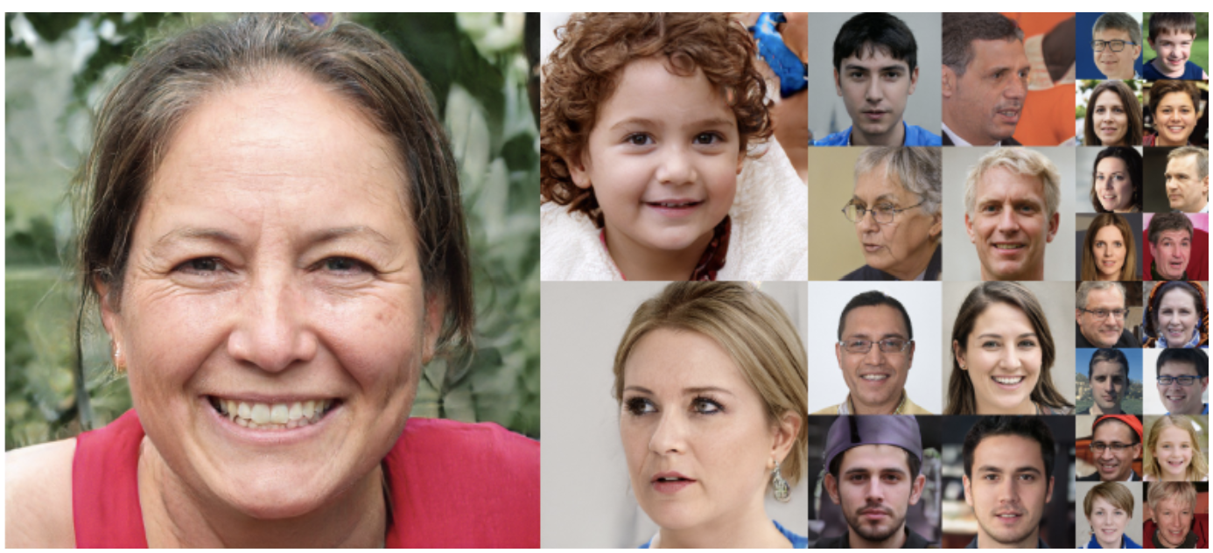
Why quantum computing & machine learning?
Formal introduction on July 16th
Machine learning has been a game changer

Slide 8
Why quantum computing & machine learning?
Formal introduction on July 16th
Machine learning has been a game changer
  GAN, Siri, Alexa, Netflix and Amazon Recommendation systems, Driverless cars

Slide 9
Why quantum computing & machine learning?
Formal introduction on July 16th
Machine learning has been a game changer
    GAN, Siri, Alexa, Netflix and Amazon Recommendation systems, Driverless cars
How to make machine learning better ?
  Tune billions of parameters of a neural networks faster
  Use ‘possibly’ quantum computing

Slide 10
Why quantum computing & machine learning?
Formal introduction on July 16th
Machine learning has been a game changer
    GAN, Siri, Alexa, Netflix and Amazon Recommendation systems, Driverless cars
How to make machine learning better ?
  Tune billions of parameters of a neural networks faster
  Use ‘possibly’ quantum computing
Quantum computing will change the face of computing in the years to come
  But it has not yet done so – many pieces of puzzles yet to be solved
    No quantum hardware, quantum algorithms are very structured, input-output loading problems, etc

Slide 11
Why quantum computing & machine learning?
Formal introduction on July 16th
Machine learning has been a game changer
    GAN, Siri, Alexa, Netflix and Amazon Recommendation systems, Driverless cars
How to make machine learning better ?
  Tune billions of parameters of a neural networks faster
  Use ‘possibly’ quantum computing
Quantum computing will change the face of computing in the years to come
  But it has not yet done so – many pieces of puzzles yet to be solved
    No quantum hardware, quantum algorithms are very structured, input-output loading problems, etc
  You can be the real one to do so!

Slide 12
Why quantum computing & machine learning?
Formal introduction on July 16th
Machine learning has been a game changer
    GAN, Siri, Alexa, Netflix and Amazon Recommendation systems, Driverless cars
How to make machine learning better ?
  Tune billions of parameters of a neural networks faster
  Use ‘possibly’ quantum computing
Quantum computing will change the face of computing in the years to come
  But it has not yet done so – many pieces of puzzles yet to be solved
    No quantum hardware, quantum algorithms are very structured, input-output loading problems, etc
  You can be the real one to do so!
  Join the course, and learn with fun (do not attach outcomes at the beginning itself: will I get a better job? Will I be able to predict stock market? Will I discover a new drug for Corona?)
    You will surely learn all the tools to become ‘one’

Slide 13
Outline of the lecture
Brief bio
Why quantum computing and machine learning?
Course coverage
What will we offer?
Skillsets tradeoffs
Other learning sources
Course evaluation

Slide 14
Course coverage
Classical stuff
  8 lectures on basics of quantum computing & ML
    How to represent data on a quantum computer?
  8 lectures on ‘textbook’ quantum algorithms

Slide 15
Course coverage
Classical stuff
  8 lectures on basics of quantum computing & ML
    How to represent data on a quantum computer?
  8 lectures on ‘textbook’ quantum algorithms
Modern stuff
  5 lectures on ‘quantum machine learning (classification, kernel methods, clustering, SVM, PCA)
  3 lectures on ‘quantum neural networks’
    Variational circuits
  7 lectures on ‘VQE & QAOA’
    Quantum chemistry, max-cut algorithm, Ising model, random walk
  1 Fault tolerant Quantum machine learning

Slide 16
Outline of the lecture
Brief bio
Why quantum computing and machine learning?
Course coverage
What will we offer?
Skillsets tradeoffs
Other learning sources
Course evaluation

Slide 17
What will we offer?
List of accessories
  Lecture notes & lecture slides
  Assignments
  Tutorials
  Projects

Slide 18
Outline of the lecture
Brief bio
Why quantum computing and machine learning?
Course coverage
What will we offer?
Skillsets tradeoffs
Other learning sources
Course evaluation

Slide 19
Skillsets tradeoffs
Input
Course
Linear algebra
Bit of probability theory
Programming
Desire to learn

Slide 20
Skillsets tradeoffs
Input
Output
Course
Linear algebra
Bit of probability theory
Programming
Desire to learn
Independent researcher in the QML

Slide 21
Skillsets tradeoffs
Input
Output
Course
Linear algebra
Bit of probability theory
Programming
Desire to learn
Independent researcher in the QML
  Top 5 participants will get to collaborate with me on a mutual problem of interest
  Apply job change
  Salary ‘hike’

Slide 22
Outline of the lecture
Brief bio
Why quantum computing and machine learning?
Course coverage
What will we offer?
Skillsets tradeoffs
Other learning sources
Course evaluation

Slide 23
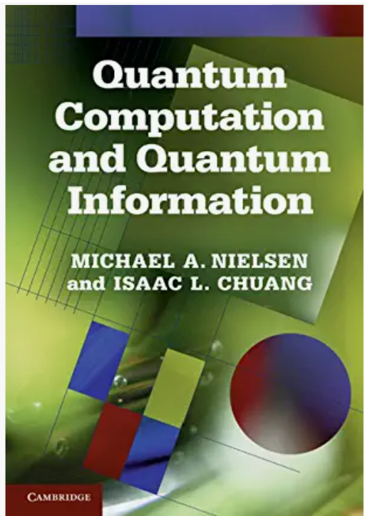
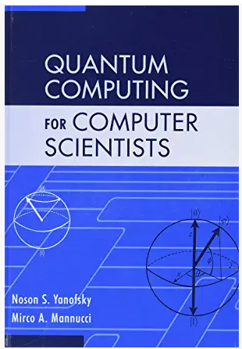
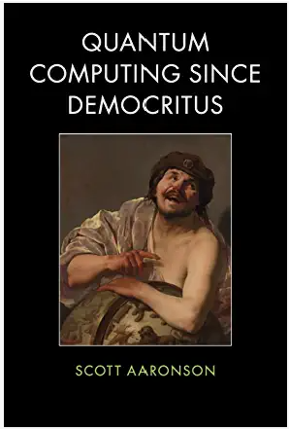
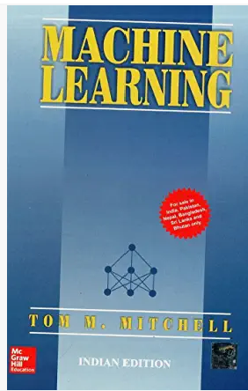
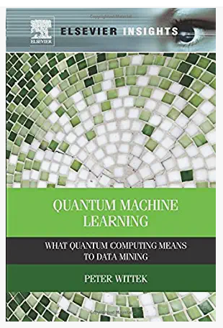
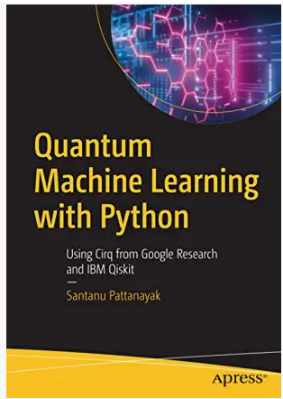
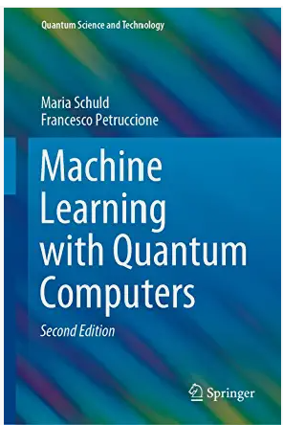
Other learning sources
Cambridge 2002
Cambridge 2008
Cambridge 2013
McGraw Hill 1997
Elsevier 2016
  Apress, 2021
  Springer, 2021

Slide 24
Other learning sources
Qiskit is available at: https://qiskit.org/
Qiskit TextBook is available at: https://qiskit.org/textbook/content/ch-ex/
Google quantum development source is available at: https://quantumai.google/

Slide 25
Outline of the lecture
Brief bio
Why quantum computing and machine learning?
Course coverage
What will we offer?
Skillsets tradeoffs
Other learning sources
Course evaluation

Slide 26
Course evaluation
Attendance (10%)
Projects (30%)
  Presentation based
Exam (60%)
  Programming & MCQs
For successful completion certification, get more than 55%.

Slide 27
Thanks for your attention &
Questions ?

